Slide 1

Ball Sort Puzzle
Heuristic Search Methods for One Player Solitaire Games
Artificial Intelligence
Master in Informatics and Computing Engineering
Gonçalo Alves – up201806451 Gustavo Mendes – up201806078
Pedro Seixas – up201806227

Slide 2
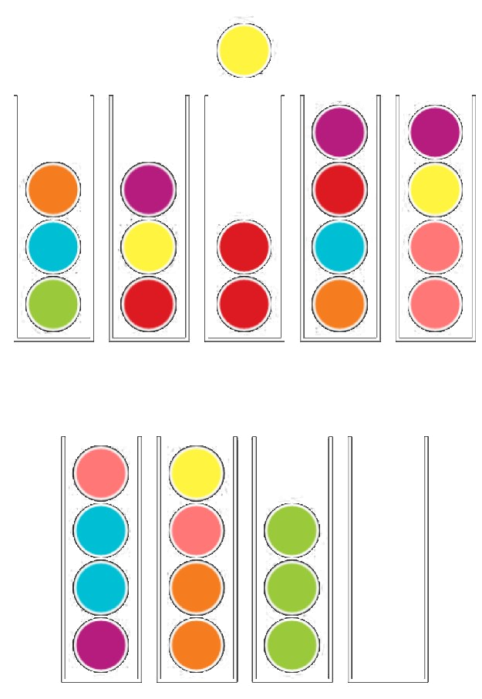

Specification
The objective of the Ball Sort Puzzle is to sort the colored balls in the tubes until all balls with the same color stay in the same tube.
The player can only move a ball at the top of a tube to:
- an empty tube;
- another tube that has a ball with the same color on top and has enough space;
The player can also undo his moves if he finds himself without moves.

Slide 3
Formulation of the problem as a search problem
State Representation:
- Ball: [1..n] (n = the number of colors)
Tube: [Ball, Ball, Ball, Ball] or []
Game: [Tube,Tube,…]
Operators:
Move(X,Y):
PreCond: Tube Y must be empty or have a Ball, on top, just like the one that is moved
Effect: move Ball from Tube X to Tube Y
Cost: 1 is the general case, it represents a move; C2, evaluation of the number of wrongly placed Balls, based on the Ball at the bottom of a Tube
Initial State:
Game: [Tube,Tube,…], where every Tube doesn’t contain 4 equal numbers
Objective State:
- Game: [Tube,Tube,…], where every Tube either contains 4 equal numbers or is empty

Slide 4
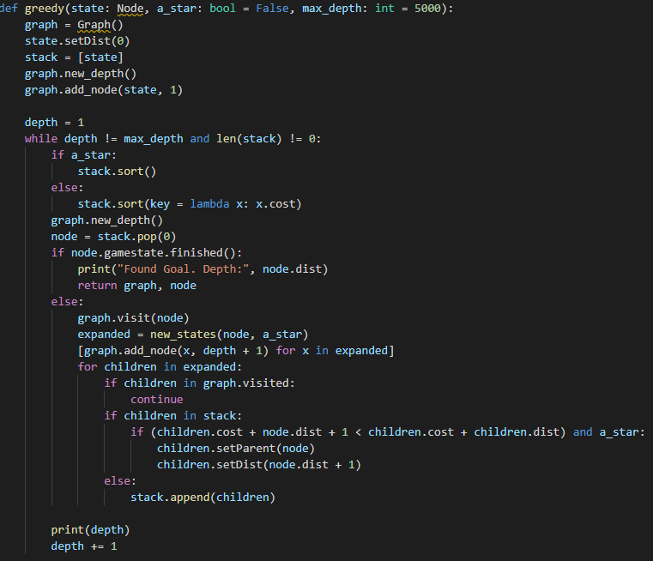
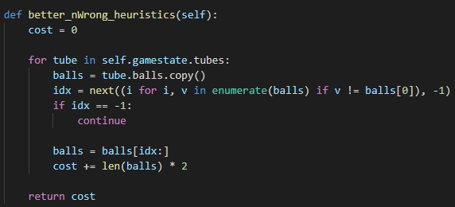
Implemented Heuristics
We have implemented BFS, DFS, IDS, Greedy Search and A*.
Our evaluation function, used in A*, calculates the number of wrongly placed Balls (Balls with different color of the Ball at the bottom) in a Tube.
Code:

Slide 5
Implementation work already carried out
Programming language: Python, with visualization using pygame package
Development environment: VSCode/IntelliJ
Data Structures:
Lists, for representing the Tubes and the Game
Nodes and Graphs
File Structure: The Project’s Repository is available at Github
Implemented Work: All algorithms lectured; Graphical Interface, playable game with hints

Slide 6
Approach
As described before, our first heuristic counted the number of wrongly placed balls in a tube, assuming that it will be needed at least one move per ball to put them in the correct place. For this second part of the project, we developed two new heuristics. The first one calculates the maximum number of consecutive balls of the same color for each color and estimates the cost by calculating how many are needed to have the 4 balls of the same color in the same tube. This heuristic calculates a score based on the number of consecutive balls of the same color and the number of empty tubes.
Ex:
1st heuristic: 2+2+1+3+2+3+2 = 15
2nd heuristic: (4-3)+(4-2)+(4-2)+(4-2)+(4-1)+(4-1) = 13
3rd heuristic: 5+5+5+5+5+5+5+15+10 = 60

Slide 7
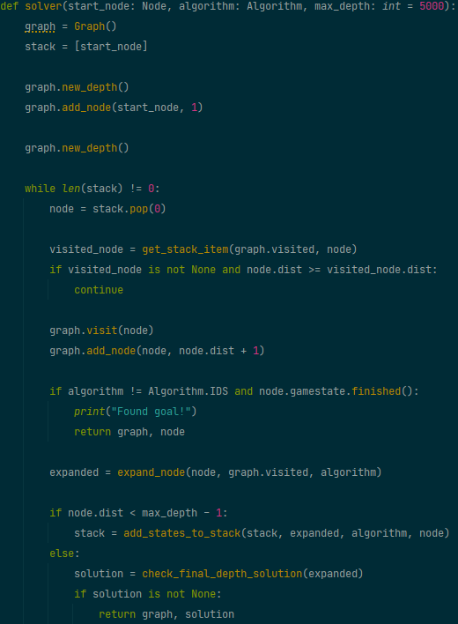
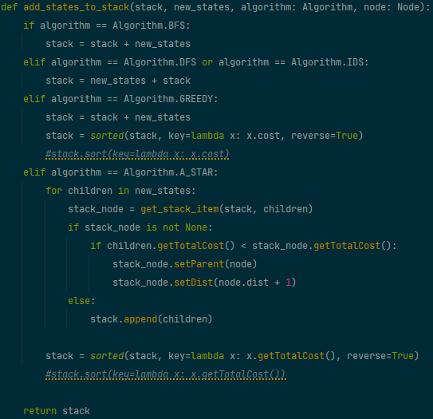
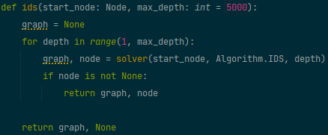
Algorithms
We have implemented all lectured algorithms: BFS, DFS, IDS, Greedy and A*. For hardware reasons, we implemented a maximum depth, making DFS a DFS-Limited.
We developed a generic “solver” function, that changes the way the nodes are expanded depending on the algorithm. For IDS, it was necessary to make a separate function, since it uses DFS. (See below)

Slide 8
Experimental Results
Initially, we expected that Greedy algorithm was going to have the best performance, time wise, since it tries to find a solution, based on a heuristic, and does not care for optimality.
Space wise, we expected that DFS-Limited would be the best, based on the table below.
Name | Time | Space | Optimal
BFS | O(b^{d+1}) | O(b^{d+1}) | YES
DFS-Limited | O(b^{l}) | O(bl) | NO
IDS | O(b^{d}) | O(bd) | YES
Greedy | O(b^{m}) | O(b^{m}) | NO
A* | O(b^{m}) | O(b^{m}) | YES

Slide 9
Experimental Results
To analyze and compare the different algorithms, we used 25 pre-existing levels. Below are the results of such tests.
Name | Completed Levels | Expanded Nodes - Avg | Time Execution (s) - Avg
BFS | 6 | 246 | 0.14152
DFS-Limited | 25 | 54 | 0.02335
IDS | 4 | 1162 | 2.77309
Greedy (Wrong Colours) | 25 | 34 | 0.01437
Greedy (Minimum Moves) | 23 | 84 | 0.04154
A* (Wrong Colours) | 25 | 852 | 1.62916
A* (Minimum Moves) | 25 | 1013 | 2.18084
Notes:
- The algorithms with less completed levels did not find a solution with the given max depth or took too much time
- While the 25 levels have different sizes, size has no correlation with solution size or difficulty and therefore, was not taken into consideration

Slide 10
Conclusions
As expected, Greedy was the best performing in terms of time, but surprisingly it was also the one that expanded the least nodes, making it the best performing algorithm overall, for non-optimal solutions.
For optimal solutions, as expected, A* was the best performing algorithm on both ends.
Between our heuristic functions, Wrong Color was the best one. Minimum Moves is better suited for small solutions or when the puzzle is almost finished.
Unfortunately, after analyzing the results for our third heuristic function, we found out it was not admissible, since it was overestimating the cost. As such, its results were not included, but the code can still be found in the graph.py file.

Slide 11
References and Materials
Link to the Google Play page;
Link of all existing levels;
We used the curricular unit’s presentations to guide our implementation of the various algorithms.
Python, with visualization using pygame package and xltw for spreadsheet generation;
VSCode/IntelliJ

